Slide 1
7FNCE040W
Business Analytics
WEEK 9
DECISION TREES

Slide 2
Today’s Schedule
Decision Trees
Practice using CPS Data set
Group course work

Slide 3
Definition
This is a tree based method used for regression and classification.
tree based methods are simple and useful for interpretation. Chapter 8 discuss this in detail bagging, random forests and boasting techniques.
Each of the methods involves producing multiple trees.
We will be considering application of decision trees to simplify a large data set.
Decision trees can be applied to both regression and classification problems.

Slide 4
A simple example Process involves splitting the data Using a series of splitting rules. This method can be applied to analyse default in companies as well as identifying dummy variables given a large data set.

Slide 5
Algorithms for building a regression tree
1. Use the reclusive binary splitting to grow a large tree on the training data stopping only when each terminal node has fewer than some minimum number of observations.
2. Apply cost complexity pruning to the large tree in order to obtain a sequence of best subsets as a function of Alpha.
3.Use K- fold cross validation to choose Alpha. That is divide the training observation into k folds.
4. Repeat process 1. & 2.
Text book discusses application to ‘Hitters data’

Slide 6
Regression trees

Slide 7
Classification trees
a classification tree is very similar to a regression tree except that it is used to predict a qualitative response rather than a quantitative one. Recall that for a regression tree the predicted response for an observation is given by the mean response of the training observation that belongs to the same terminal node. In contrast, for a classification tree, we predict that each observation belongs to the most commonly occurring class of training observations in the region to which it belongs.
In interpreting the results of a classification tree, we are often interested not only in the class prediction but also in the class proportions among the training observations that fall into that region.
A full explanation of this technique can be found in chapter eight of the textbook.
These techniques are used by medics to predict likelihood of a disease based on a series of questions. These techniques are also useful for forecasting default risk.

Slide 8
Advantages and disadvantages of trees
Advantages
1 trees are very easy to explain to people. In fact, there even easier to explain that linear regression.
2.Some people believe that decision trees more closely mirror human decision-making then do the regression and classification approaches discussed in the previous weeks
3.trees can be displayed graphically and are easier to interpret even by a non expert.
4.Trees can easily handle qualitative predictors without the need to create dummy variables.
Disadvantage
Trees can be very non robust. In other words is small change in the data can cause a large change in the final estimated tree.
Unfortunately, trees generally do not have the same level or predictive accuracy as some of the other regression and classification approaches.

Slide 9
Machine Learning FAQ
How does the random forest model work? How is it different from bagging and boosting in ensemble models?
Let’s assume we use a decision tree algorithms as base classifier for all three: boosting, bagging, and (obviously :)) the random forest.
Why and when do we want to use any of these? Given a fixed-size number of training samples, our model will increasingly suffers from the “curse of dimensionality” if we increase the number of features. The challenge of individual, unpruned decision trees is that the hypothesis often ends up being too complex for the underlying training data – decision trees are prone to overfitting.
tl;dr: Bagging and random forests are “bagging” algorithms that aim to reduce the complexity of models that overfit the training data. In contrast, boosting is an approach to increase the complexity of models that suffer from high bias, that is, models that underfit the training data.

Slide 10
Bagging, random forest, boosting.
These techniques use trees as building blocks to construct more powerful prediction models.
Bagging
this is a general purpose procedure for reducing the variance of a statistical learning method. Decision trees often suffer from high variance. This means if we split the training data into two parts at random and fit a decision tree to both halves, the result that we could get may be quite different. In contrast, a procedure with low variance will yield similar results if applied repeatedly to distinct data sets.
With bootstrap we take repeated samples from a single training data set. We then train our method on the bootstrap training set and finally average all the predictions this is called bagging

Slide 11
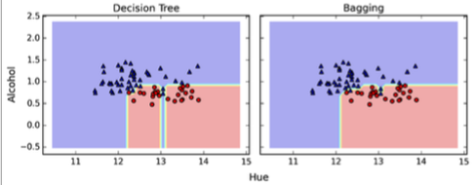
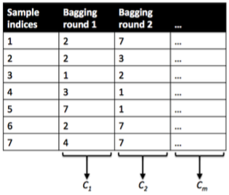
Bagging
Now, let’s take a look at the probably “simplest” case, bagging. Here, we train a number (ensemble) of decision trees from bootstrap samples of your training set. Bootstrap sampling means drawing random samples from our training set with replacement. E.g., if our training set consists of 7 training samples, our bootstrap samples (here: n=7) can look as follows, where C1, C2, … Cm shall symbolize the decision tree classifiers:
After we trained your (m) decision trees, we can use them to classify new data via majority rule. For instance, we’d let each decision tree make a decision and predict the class label that received more votes. Typically, this would result in a less complex decision boundary, and the bagging classifier would have a lower variance (less overfitting) than an individual decision tree. Below is a plot comparing a single decision tree (left) to a bagging classifier (right) for 2 variables from the Wine dataset (Alcohol and Hue).

Slide 12
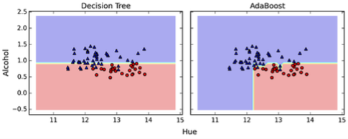
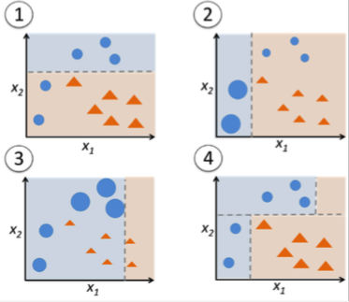
Boosting
In contrast to bagging, you use very simple classifiers as base classifiers, so-called “weak learners.” Picture these weak learners as “decision tree stumps” – decision trees with only 1 splitting rule. Below, we will refer to the probably most popular example of boosting, AdaBoost. Here, we start with one decision tree stump (1) and “focus” on the samples it got wrong. In the next round, we train another decision tree stump that attempts to get these samples right (2); we achieve this by putting a larger weight on these training samples. Again, this 2nd classifier will likely get some other samples wrong, so you’d re-adjust the weights …
In a nutshell, we can summarize “Adaboost” as “adaptive” or “incremental” learning from mistakes. Eventually, we will come up with a model that has a lower bias than an individual decision tree (thus, it is less likely to underfit the training data).

Slide 13
Boosting
Boosting is another approach for improving predictions resulting from a decision tree
. Like bagging, boosting is a general approach that can be applied to many statistical learning methods for regression or classification. Who will restrict our discussions of boosting to the context of decision trees.
to recap backing involves creating multiple copies of the original training data set using the bootstrap fitting a separate decision tree to each copy, and then combining all of the trees in order to create a single predictive model. Boosting works in a similar way except that the trees are grown sequentially, each tree is grown using information from previously grown trees.
Idea behind this procedure he's got the boosting approach launch slowly so avoids potentially overfitting the data each of these trees can be rather small with just a few terminal nodes.

Slide 14
Random forests
The random forest algorithm is actually a bagging algorithm: also here, we draw random bootstrap samples from your training set. However, in addition to the bootstrap samples, we also draw random subsets of features for training the individual trees; in bagging, we provide each tree with the full set of features. Due to the random feature selection, the trees are more independent of each other compared to regular bagging, which often results in better predictive performance (due to better variance-bias trade-offs), and I’d say that it’s also faster than bagging, because each tree learns only from a subset of features.

Slide 15
Random forests
provides an improvement over bag trees by way of a small tweak that decorrelates the trees.
Here we build a number of decision trees on bootstrapped training samples
In building a random forest at each split in the tree the algorithm is not even allowed to consider a majority of the available predictors. Suppose there is only one very strong predictor in the data set, along with a number of other moderate strong predictors. Then in the collection of packed trees most or all of the trees will be used with this strong predictor in the top split.
this technique has been used to predict cancer type cells based on 500 genes that have the largest variance in the training set.
Although this is useful technique in today's session we will only consider simple tree diagrams

Slide 16
Open file ‘CPS individual coursework data .sav’
we will use this data to show how we can apply another technique more unsupervised data regression decision trees.
Let's assume we need to find out what items in the data set contributes to customers considering a strategic alliance with CPS.
In this case we will use all the data provided and start building a decision tree which will identify the key questions which determine the likelihood that the customers will form the strategic alliance with CPS.

Slide 17
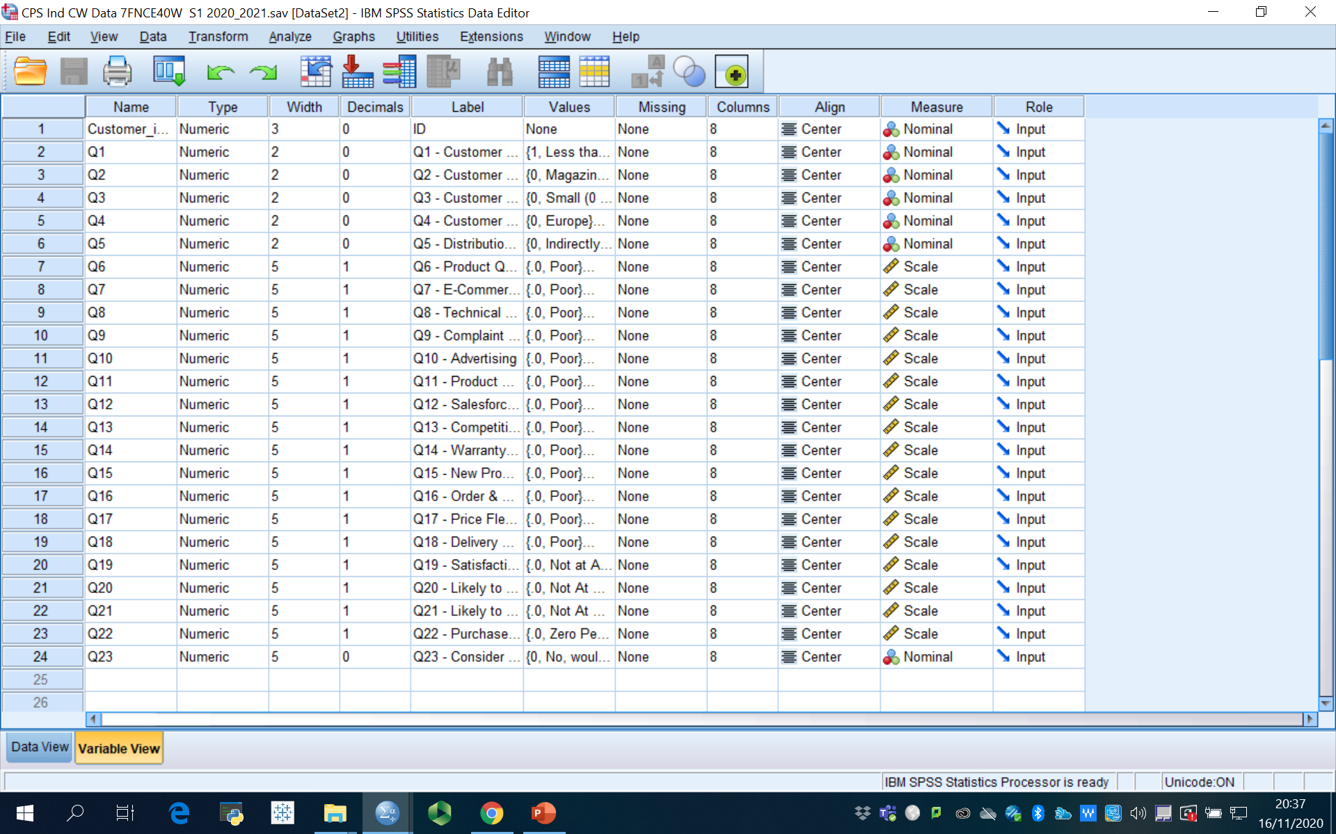
CPS data set : 200 cases , 23 questions

Slide 18
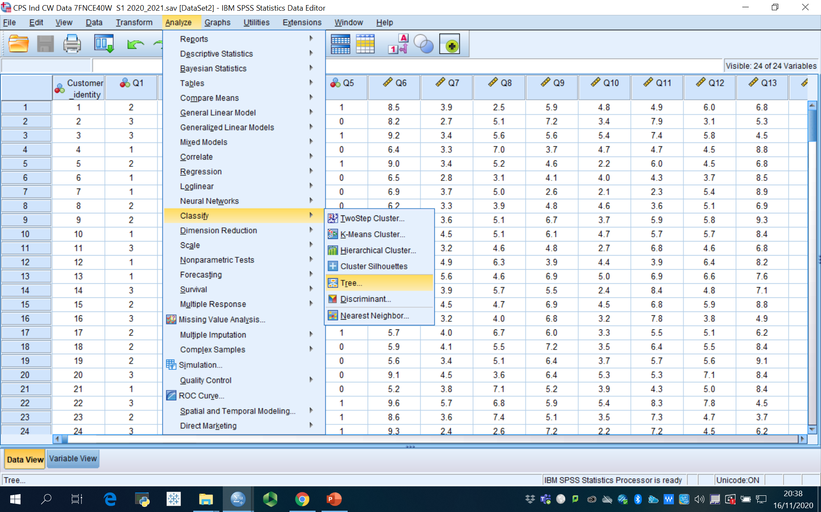
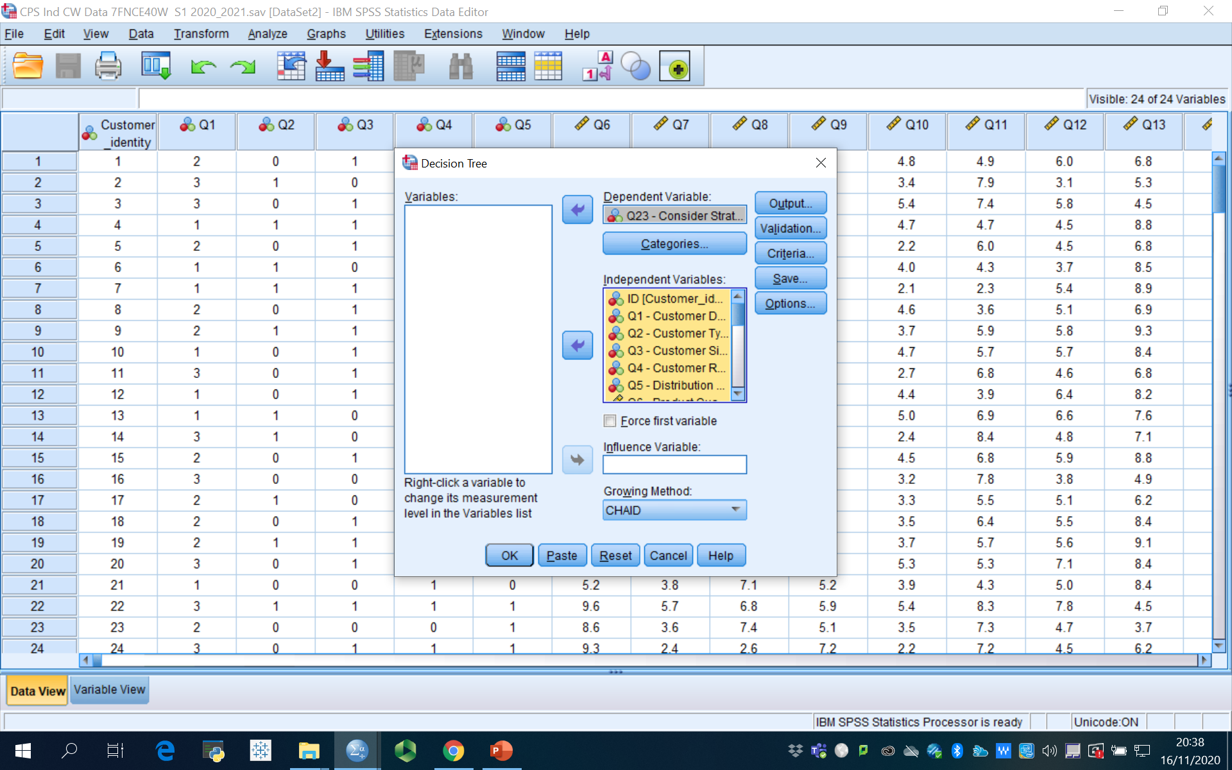
Select the decision tree option from the classification

Slide 19
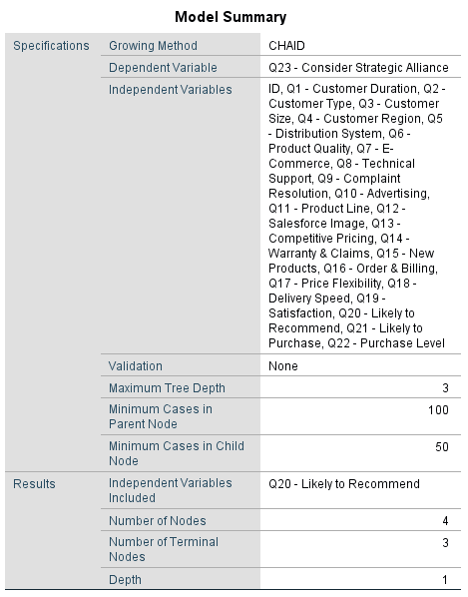
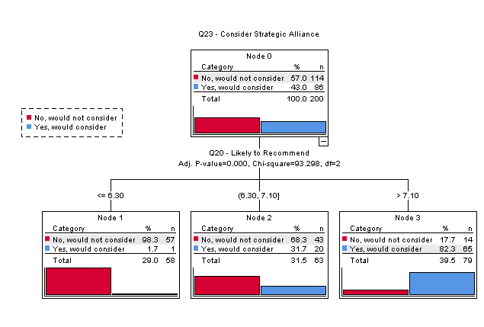

Slide 20
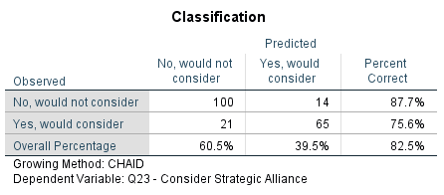
Output for step 1

Slide 21
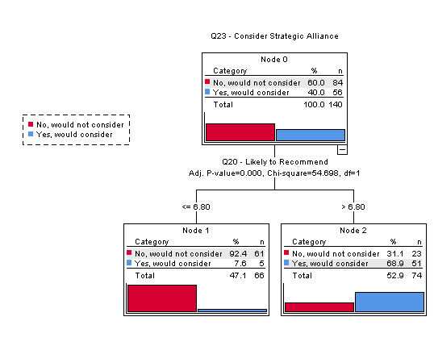
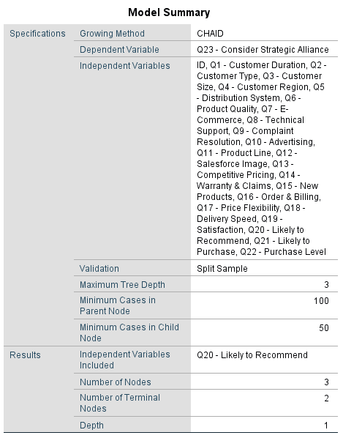
Step 2 Validation of the results Use split sample Training sample 70% , Test 30% ➔ Display results for Training & Test samples ➔ continue
Let growing method = CHAID
➔ Continue

Slide 22
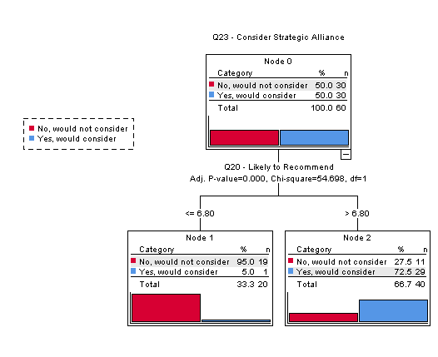
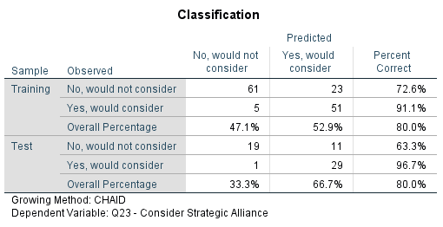
Test Sample is similar to Training sample

Slide 23
Step 3 Select the customer segment i.e. customers who would form an alliance with CPS
From Categories select √ yes, would consider
Then continue…
From Output ‘Rules’ ➔ generate classification rules➔ Nodes---Best terminal nodes – ‘ number of nodes = 5.
Syntex …> ‘Simple Text’ ➔ continue

Slide 24
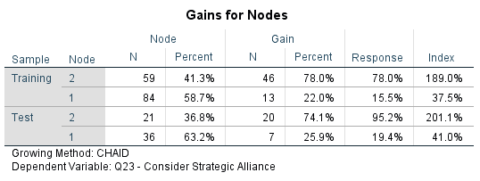
Target; Yes, would consider

Slide 25
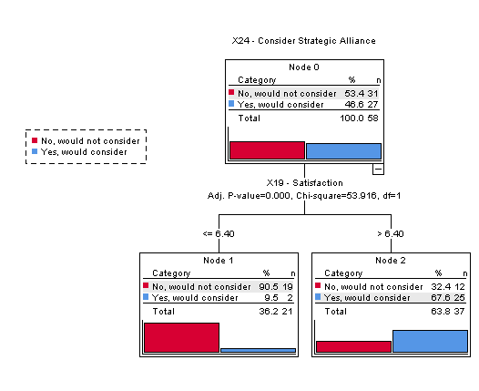

Training and Test

Slide 26
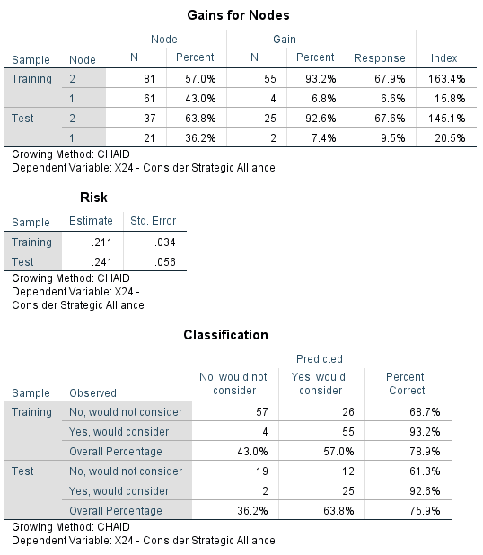

Slide 27
Interpretation of the output.
/***** For Target Category 1 *****/
/* Node 2 */.
IF (X19 - Satisfaction IS MISSING OR (X19 - Satisfaction > 6.4))
THEN
Node = 2
Prediction = 1
Probability = 0.679012
/* Node 1 */.
IF (X19 - Satisfaction NOT MISSING AND (X19 - Satisfaction <= 6.4))
THEN
Node = 1
Prediction = 0
Probability = 0.934426

Slide 28
BREAK 10 mins

Slide 29
Practice with generating a dummy variable for Highly satisfied vs Not satisfied. From the group data set.
Using this as a DV draw a tree diagram to see which ‘aspects’ are important in determining satisfied customers.
Explore if the Highly satisficed customers will buy more units from the company.

Slide 30
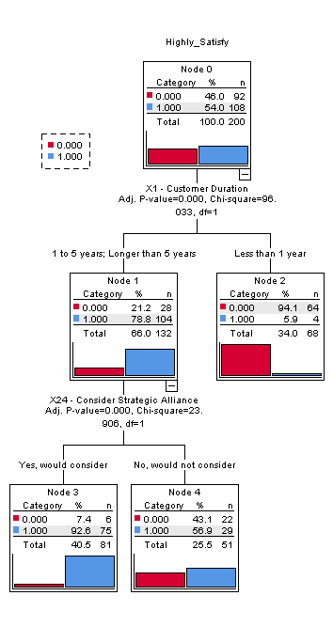

Slide 31
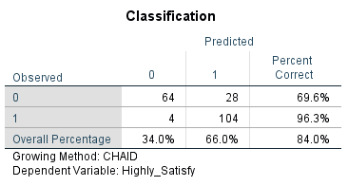

Slide 32
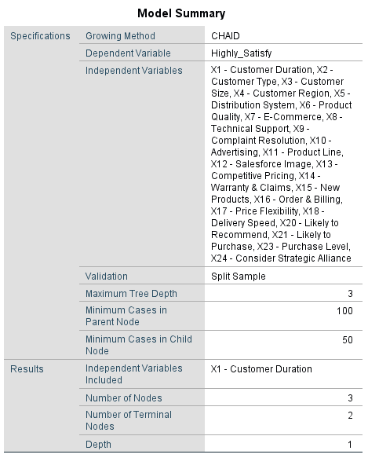

Slide 33
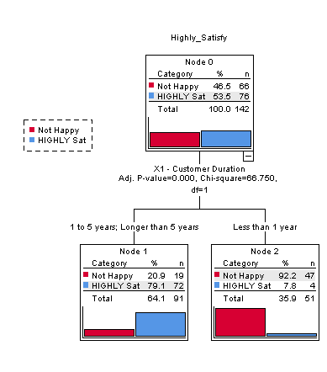
Training Sample

Slide 34
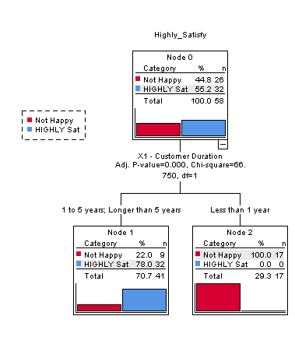
Test Sample

Slide 35
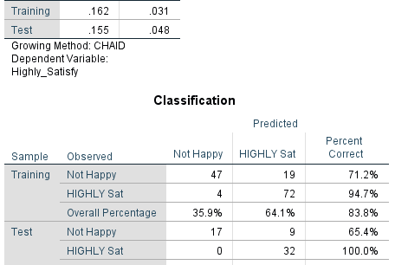

Slide 36
Working in groups prepare for Group Presentation

